Slide 1
ShopEZ: E-commerce Application
KARUNYA M (au211521205062)
JAYAVIDHYA S R (au211521205057)
KRISHNAVENI K (au211521205070)
LAKSHITHA A D (au211521205072)

Slide 2
ABSRACT:
ShopEZ is an innovative e-commerce platform developed using the MERN stack, which includes MongoDB, Express.js, React.js, and Node.js. Designed to provide a seamless online shopping experience.
ShopEZ focuses on user convenience and satisfaction by integrating a range of features that enhance product discovery and streamline the purchasing process.
The platform incorporates an intuitive user interface that facilitates easy navigation and efficient checkout, ensuring that customers can quickly find and purchase products.

Slide 3
INTRODUCTION:
ShopEZ is an e-commerce platform built to provide users with a convenient and enjoyable shopping experience. In today’s fast-paced world, online shopping has become a necessity, and our platform aims to meet this demand by offering an easy-to-use interface and robust backend that supports key features such as product listings, a shopping cart, and secure payment options. Our goal is to make the online shopping journey smoother, from product discovery to order completion, with a focus on user satisfaction and security.

Slide 4
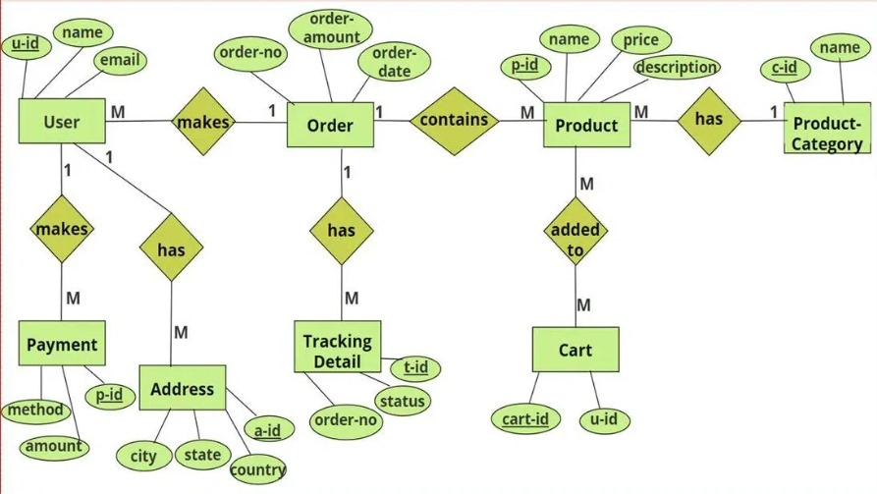
ER DIAGRAM

Slide 5
PROPOSED SYSTEM:
ShopEZ has several exciting features in the pipeline. We plan to integrate AI-powered product recommendations to provide personalized suggestions for users based on their browsing history.
Real-time inventory updates will ensure that product availability is accurate at all times, preventing users from ordering out-of-stock items.
Additionally, we are exploring multi-language support to reach a wider audience and offering more payment gateways to cater to global users.
Scalability is a key priority, allowing the platform to handle thousands of users and products seamlessly.

Slide 6
FRONTEND DEVELOPMENT:
The frontend of ShopEZ was developed using HTML, CSS, and JavaScript, with React (or Angular) as the main framework for creating a dynamic and responsive user interface.
Our design approach focused on simplicity and user-friendliness, ensuring that users can easily browse through product categories, view details, and add items to their shopping cart.
Features like product search and filters help users quickly find what they are looking for. We also ensured that the design , providing an optimal experience on any device.

Slide 7
BACKEND DEVELOPMENT:
The backend development of ShopEZ relies on Node.js and Express.js, providing a reliable foundation for handling requests from the frontend.
We built a RESTful API that connects with the frontend, processes user requests (like logging in, browsing products, and placing orders), and communicates with the database.
MongoDB (or MySQL) was used for storing user information, product details, and order data. To ensure secure authentication, we implemented JWT (JSON Web Tokens), which verifies user sessions and protects sensitive data.
This setup allows for smooth interaction between the frontend and backend, ensuring a secure and efficient system.
.

Slide 8
INTEGRATION:
The integration between the frontend and backend is one of the most crucial elements of the ShopEZ platform.
When a user interacts with the frontend—for example, by adding an item to their cart—the backend processes this request, checks product availability in the database, and sends the necessary information back to the frontend.
This constant communication ensures that all actions are synchronized in real-time. For example, if a product is out of stock, the backend informs the user immediately, preventing any issues during the checkout process.
The key integration challenge we faced was ensuring that the system can handle multiple users interacting at the same time, which was resolved using efficient request handling and database optimization.

Slide 9
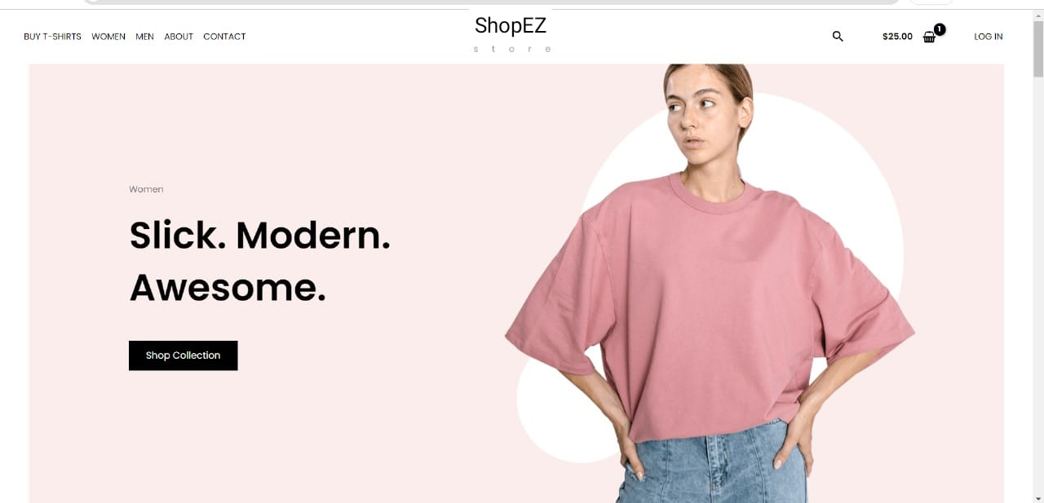
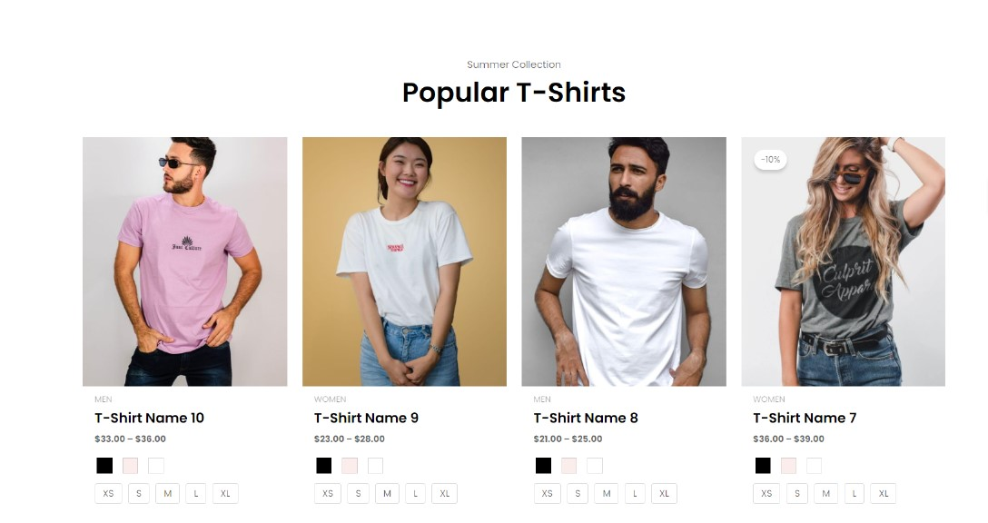
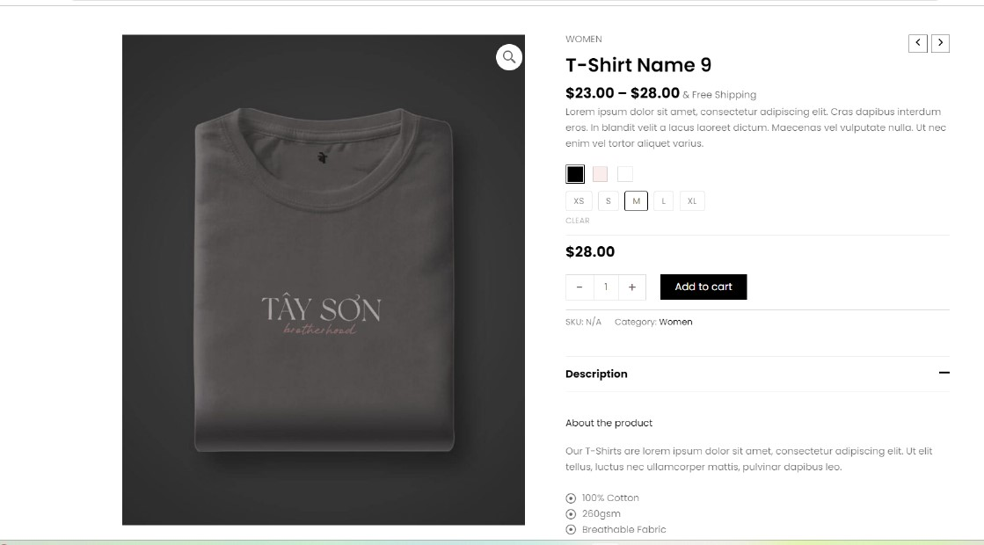
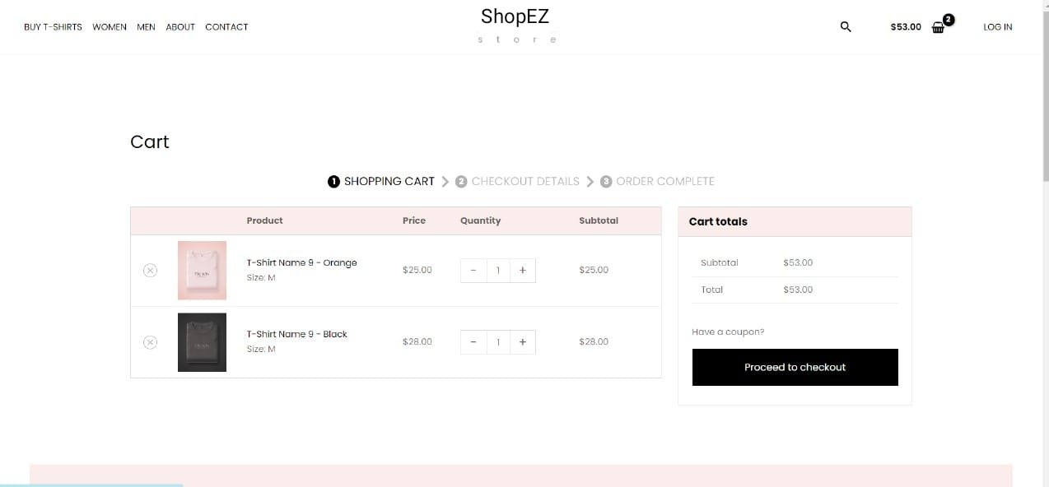
Sample Model

Slide 10
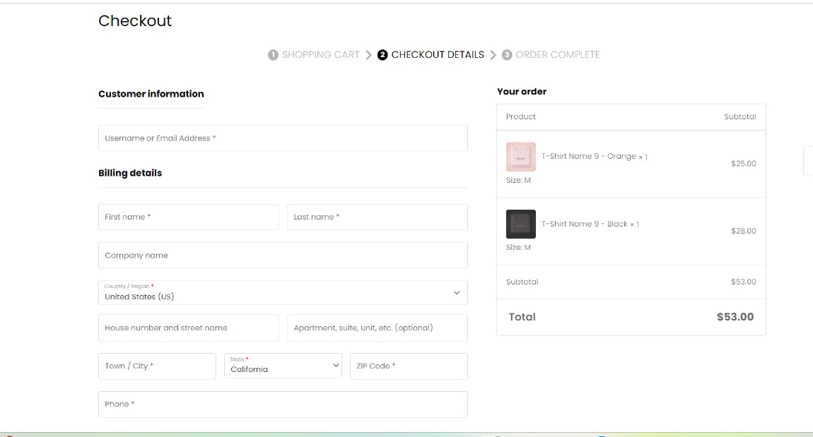
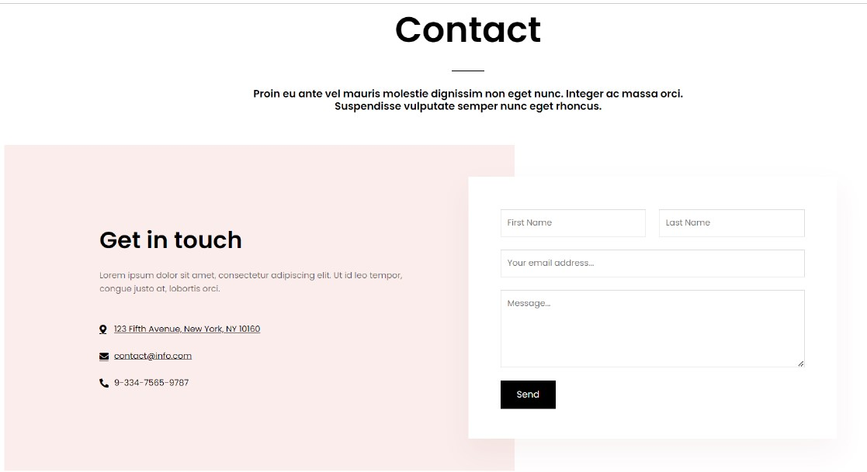

Slide 11
CONCLUSION:
In conclusion, ShopEZ offers a robust and user-friendly solution for online shopping. By integrating both frontend and backend systems, we have created a platform that ensures a smooth user experience while maintaining data security and performance.
Moving forward, we aim to enhance the platform with more features such as AI-based recommendations and increased scalability. ShopEZ is not just a shopping platform; it’s a system designed with the user’s convenience and satisfaction at its core.

Slide 12
THANK YOU

